Slide 1
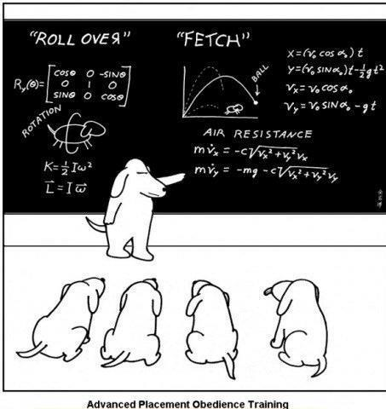
Electron & Hole Statistics in Semiconductors More Details

Slide 2
  NOTE!!
  Much of what follows (including the color scheme) was borrowed from a lecture posted on the web by Prof. Beşire GÖNÜL in Turkey.
  Her lectures are posted Here: http://www1.gantep.edu.tr/~bgonul/dersnotlari/.
  Her homepage is Here: http://www1.gantep.edu.tr/~bgonul/.

Slide 3

CHAPTER 3
CARRIER CONCENTRATIONS IN SEMICONDUCTORS
Prof. Dr. Beşire GÖNÜL

Slide 4
CARRIER CONCENTRATIONS IN SEMICONDUCTORS
Donors and Acceptors
Fermi level , E_{f}
Carrier concentration equations
Donors and acceptors both present

Slide 5
Donors and Acceptors
The conductivity of a pure (intrinsic) s/c is low due to the low number of free carriers.
The number of carriers are generated by thermally or electromagnetic radiation for a pure s/c.
For an intrinsic semiconductor
n = p = n_{i}
n = concentration of electrons per unit volume
p = concentration of holes per unit volume
n_{i} = the intrinsic carrier concentration of the semiconductor under consideration.

Slide 6
n.p = n_{i}²
n = p
number of e⁻’s in CB = number of holes in VB
This is due to the fact that when an e⁻ makes a transition to the CB, it leaves a hole behind in VB. We have a bipolar (two carrier) conduction and the number of holes and e⁻ ‘s are equal.
n.p = n_{i}²
This equation is called as mass-action law.

Slide 7
n.p = n_{i}²
The intrinsic carrier concentration n_{i} depends on;
the semiconductor material, and
the temperature.
For silicon at 300 K, n_{i} has a value of 1.4 x 10¹⁰ cm^{-3.}
Clearly , equation (n = p = n_{i}) can be written as
n.p = n_{i}²
This equation is valid for extrinsic as well as intrinsic material.

Slide 8
What is doping and dopants impurities ?
To increase the conductivity, one can dope pure s/c with atoms from column lll or V of periodic table. This process is called as doping and the added atoms are called as dopants impurities.
There are two types of doped or extrinsic s/c’s;
n-type
p-type
Addition of different atoms modify the conductivity of the intrinsic semiconductor.

Slide 9
p-type doped semiconductor
Si + Column lll impurity atoms
Electron
Have four valance e⁻’s
Boron (B)
has three valance e⁻’ s
Hole
Si
Bond with missing
electron
Si
B
Si
Boron bonding in Silicon
Boron sits on a lattice side
Normal bond with two electrons
Si
p >> n

Slide 10
Boron(column III) atoms have three valance electrons, there is a deficiency of electron or missing electron to complete the outer shell.
This means that each added or doped boron atom introduces a single hole in the crystal.
There are two ways of producing hole
1) Promote e⁻’s from VB to CB,
2) Add column lll impurities to the s/c.

Slide 11
Energy Diagram for a p-type s/c
CB
E_{c} = CB edge energy level
acceptor
(Column lll) atoms
E_{g}
E_{A}= Acceptor energ level
E_{v} = VB edge energy level
VB
Electron
Hole
The energy gap is forbidden only for pure material, i.e. Intrinsic material.

Slide 12
p-type semiconductor
The impurity atoms from column lll occupy at an energy level within E_{g} . These levels can be
Shallow levels which is close to the band edge,
Deep levels which lies almost at the mid of the band gap.
If the E_{A} level is shallow i.e. close to the VB edge, each added boron atom accepts an e⁻ from VB and have a full configuration of e⁻’s at the outer shell.
These atoms are called as acceptor atoms since they accept an e⁻ from VB to complete its bonding. So each acceptor atom gives rise a hole in VB.
The current is mostly due to holes since the number of holes are made greater than e⁻’s.

Slide 13
Holes = p = majority carriers
Electrons = n = minority carriers
Majority and minority carriers in a p-type semiconductor
Electric field direction
t₁
t₂
Holes movement as a
function of applied electric field
t₃
Hole movement direction
Electron movement direction

Slide 14
E_{c}
Electron
E_{g}
E_{a}
Si
Weakly bound electron
E_{v}
Electron
Si
P
Si
Hole
Shallow acceptor in silicon
Si
Normal bond with two electrons
Phosporus bonding in silicon

Slide 15
Conduction band
E_{c}
E_{c}
E_{a}
E_{d}
Neutral donor centre
İonized (+ve)
donor centre
E_{g}
Band gap is 1.1 eV for silicon
E_{v}
Valance band
E_{v}
E_{c}
Neutral acceptor centre
İonized (-ve)
acceptor centre
Electron
Shallow donor in silicon
E_{a}
E_{v}
Electron
Hole
Donor and acceptor charge states

Slide 16
n-type semiconductor
Si
Si
As
Extra e⁻ of column V atom is weakly attached to its host atom
Si
Si
Si + column V (with five valance e⁻ )
E_{c}
E_{D} = Donor energy level (shallow)
E_{g}
ionized (+ve)
donor centre
Band gap is 1.1 eV for silicon
Electron
E_{v}
Hole
n - type semiconductor

Slide 17
n_{p} , p_{n}
n-type , n >> p ; n is the majority carrier concentration n_{n}
p is the minority carrier concentration p_{n}
p-type , p >> n ; p is the majority carrier concentration p_{p}
n is the minority carrier concentration n_{p}
n_{p} p_{n}
Type of semiconductor

Slide 18
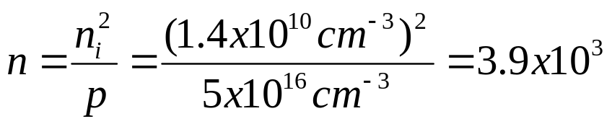
calculation
Calculate the hole and electron densities in a piece of p-type silicon that has been doped with 5 x 10¹⁶ acceptor atoms per cm³ .
n_{i} = 1.4 x 10¹⁰ cm⁻³ ( at room temperature)
Undoped
n = p = n_{i}
p-type ; p >> n
n.p = n_{i}² N_{A} = 5 x 10¹⁶ p = N_{A} = 5 x 10¹⁶ cm⁻³
electrons per cm³
p >> n_{i} and n << n_{i} in a p-type material. The more holes you put in the less e⁻’s you have and vice versa.

Slide 19
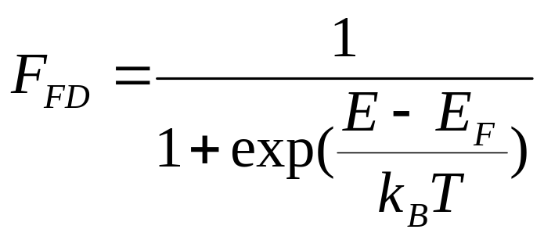
Fermi level , E_{F}
This is a reference energy level at which the probability of occupation by an electron is ½.
Since E_{f} is a reference level therefore it can appear anywhere in the energy level diagram of a S/C .
Fermi energy level is not fixed.
Occupation probability of an electron and hole can be determined by Fermi-Dirac distribution function, F_{FD} ;
E_{F} = Fermi energy level
k_{B} = Boltzman constant
T = Temperature

Slide 20
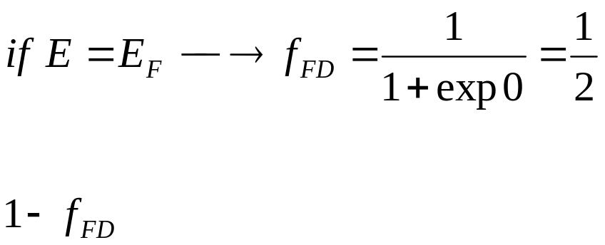
Fermi level , E_{F}
E is the energy level under investigation.
F_{FD} determines the probability of the energy level E being occupied by electron.
determines the probability of not finding an electron at an energy level E; the probability of finding a hole .

Slide 21
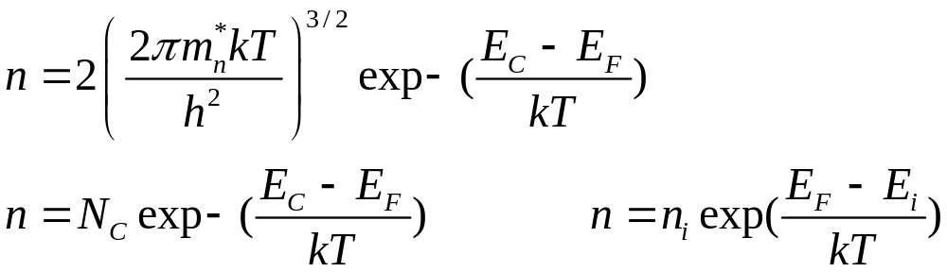
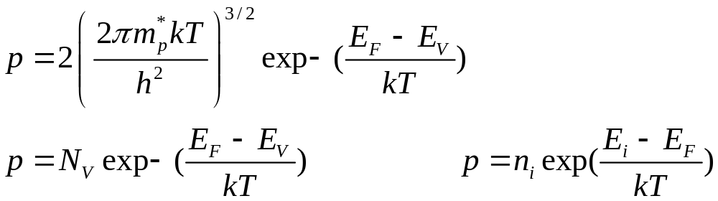
Carrier concentration equations
The number density, i.e., the number of electrons available for conduction in CB is
The number density, i.e., the number of holes available for conduction in VB is

Slide 22
Donors and acceptors both present
Both donors and acceptors present in a s/c in general. However one will outnumber the other one.
In an n-type material the number of donor concentration is significantly greater than that of the acceptor concentration.
Similarly, in a p-type material the number of acceptor concentration is significantly greater than that of the donor concentration.
A p-type material can be converted to an n-type material or vice versa by means of adding proper type of dopant atoms. This is in fact how p-n junction diodes are actually fabricated.

Slide 23
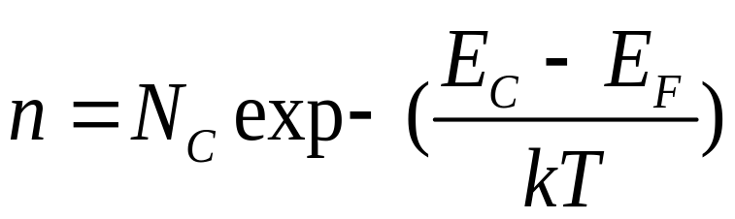
Worked example
How does the position of the Fermi Level change with
increasing donor concentration, and
increasing acceptor concentration ?
We shall use equation
İf n is increasing then the quantity E_{C}-E_{F} must be decreasing i.e. as the donor concentration goes up the Fermi level moves towards the conduction band edge E_{c}.

Slide 24
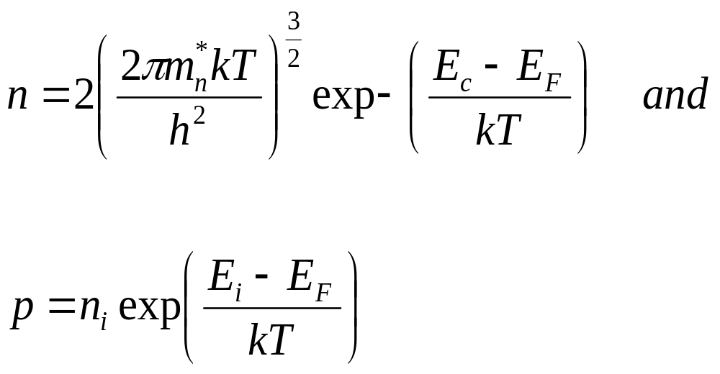
Worked example
But the carrier density equations such as;
aren’t valid for all doping concentrations! As the fermi-level comes
to within about 3kT of either band edge the equations are no longer
valid, because they were derived by assuming the simpler Maxwell
Boltzmann statics rather than the proper Fermi-Dirac statistic.

Slide 25
Worked example
n₁
n₂
n₃
E_{C}
E_{F2}
E_{F3}
E_{F1}
E_{g}/2
E_{g}/2
E_{g}/2
E_{V}
n₃ > n₂ > n₁
E_{C}
E_{g}/2
E_{g}/2
E_{g}/2
E_{F1}
E_{F2}
E_{F3}
E_{V}
p₁
p₂
p₃
p₃ > p₂ > p₁

Slide 26
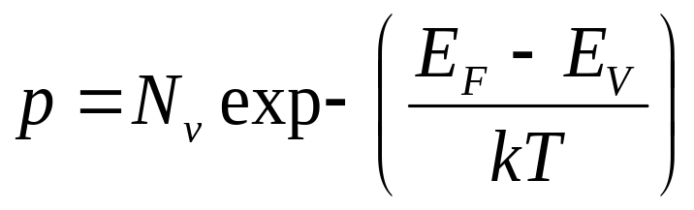
Worked example
(b) Considering the density of holes in valence band;
It is seen that as the acceptor concentration increases, Fermi-level
moves towards the valance band edge. These results will be used in
the construction of device (energy) band diagrams.

Slide 27

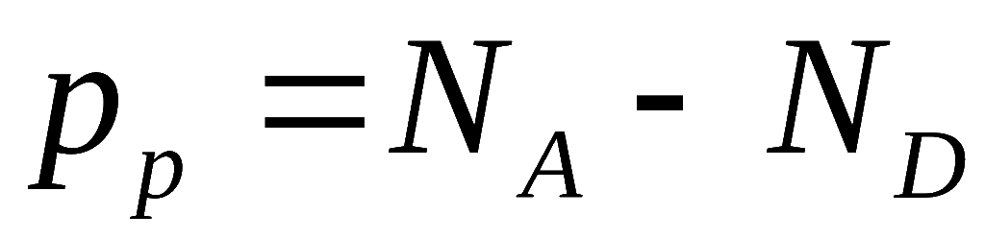
Donors and acceptor both present
In general, both donors and acceptors are present in a piece of a semiconductor although one will outnumber the other one.
The impurities are incorporated unintentionally during the growth of the semiconductor crystal causing both types of impurities being present in a piece of a semiconductor.
How do we handle such a piece of s/c?
1) Assume that the shallow donor concentration is significantly greater than that of the shallow acceptor concentration. In this case the material behaves as an n-type material and
2) Similarly, when the number of shallow acceptor concentration is signicantly greater than the shallow donor concentration in a piece of a s/c, it can be considered as a p-type s/c and

Slide 28
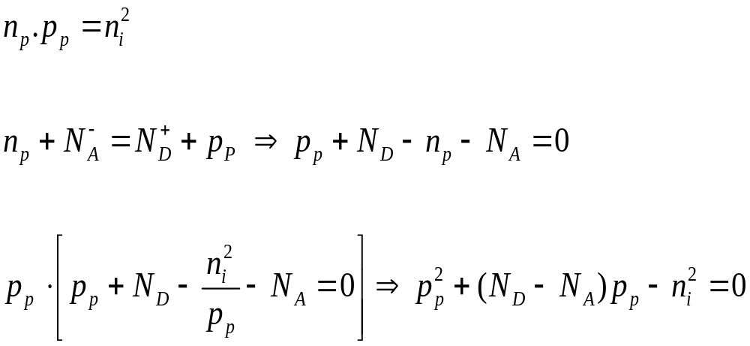
Donors and acceptor both present
For the case N_{A}>N_{D} , i.e. for p-type material

Slide 29
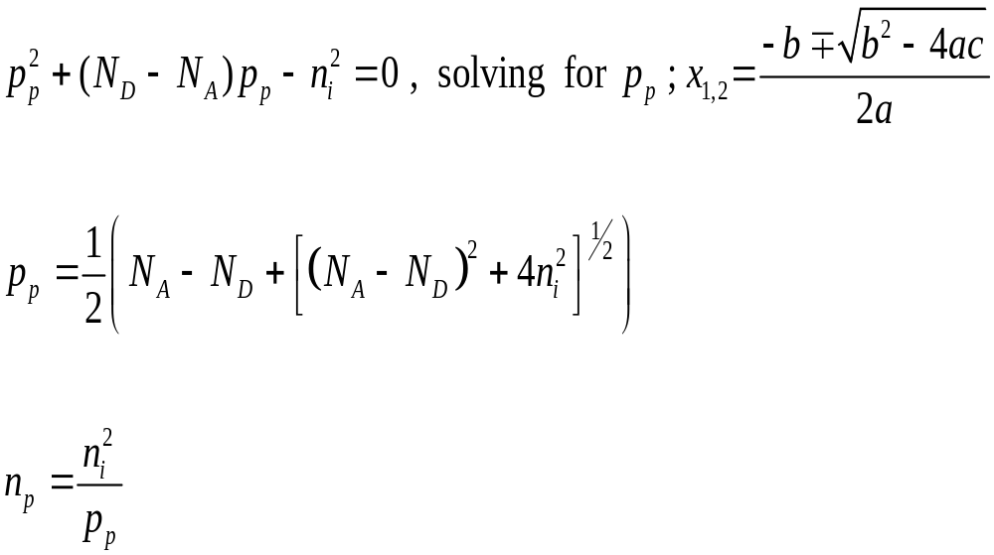
Donors and acceptor both present
majority
minority

Slide 30
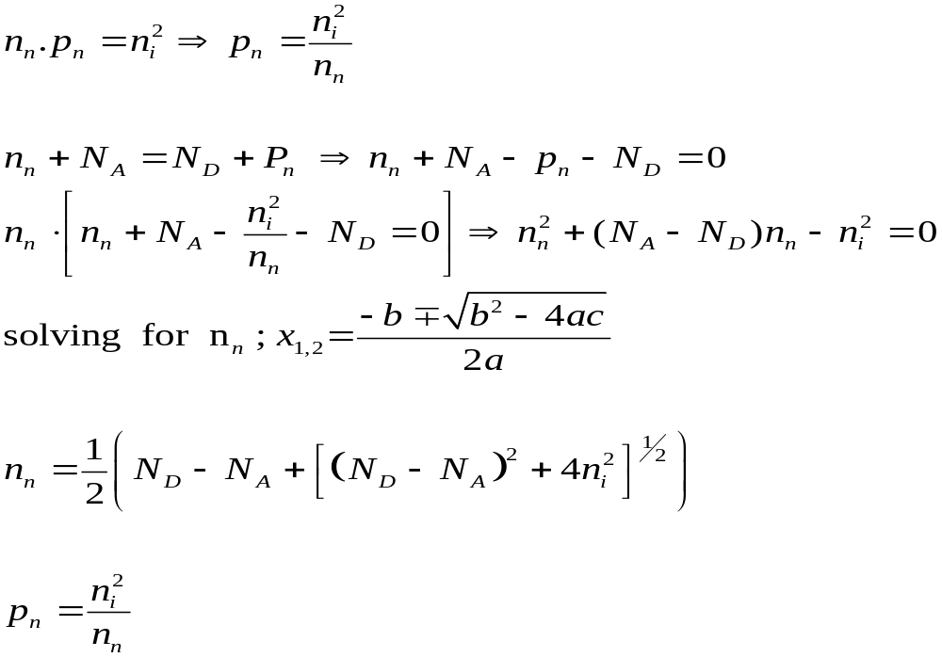
Donors and acceptor both present
For the case N_{D}>N_{A} , i.e. n-type material

Slide 31
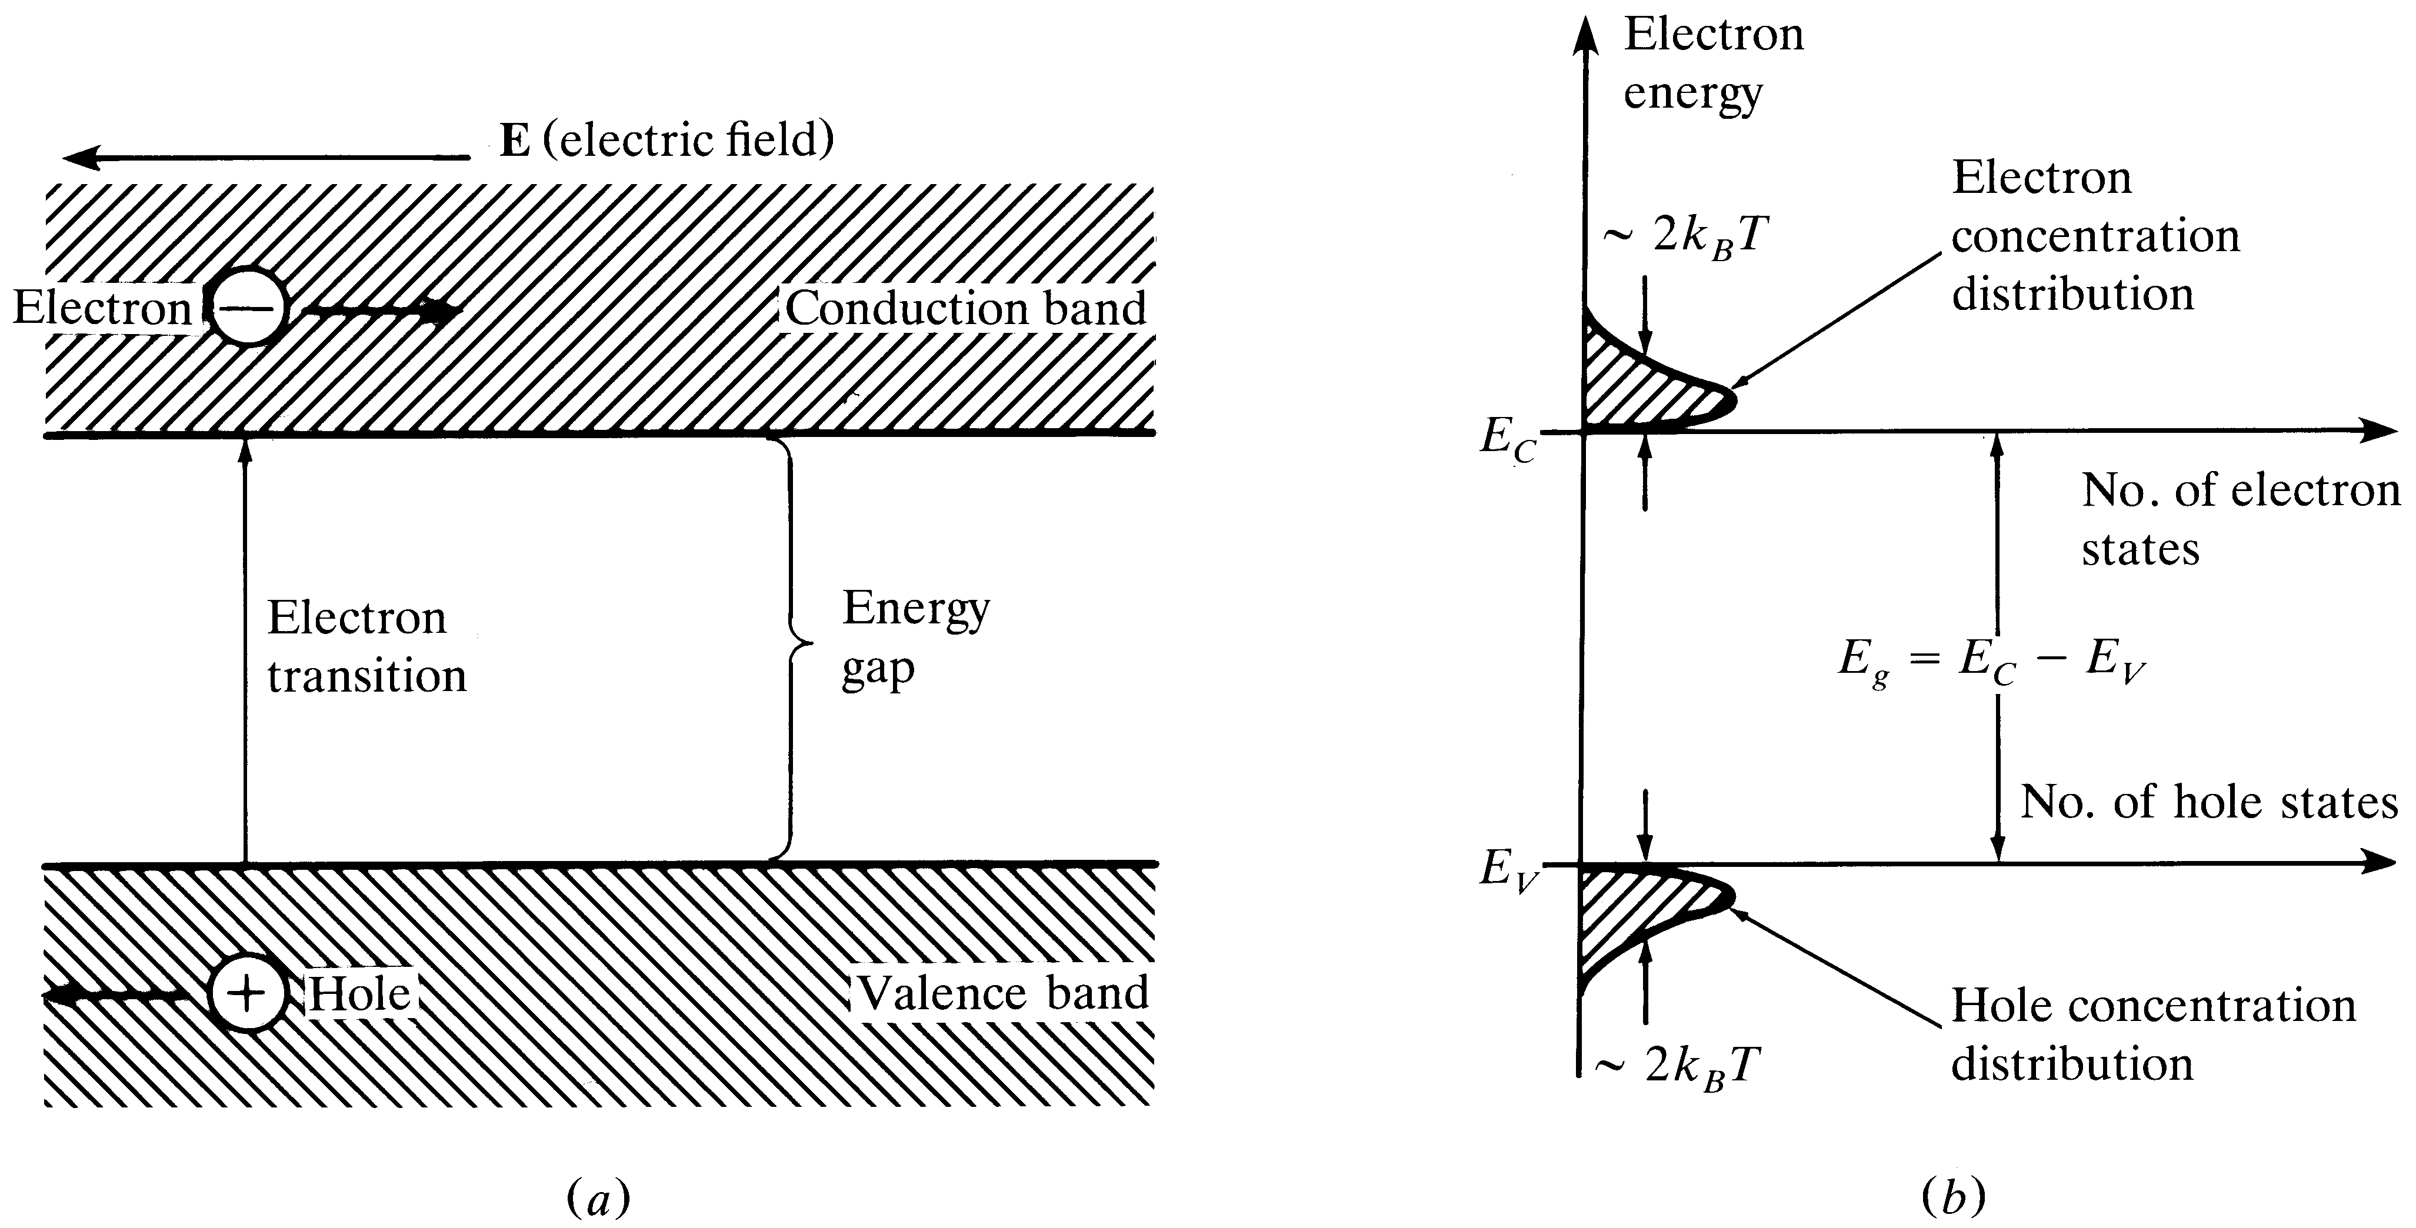

a) Energy level diagrams showing the excitation of an electron from the valence band to the conduction band.
The resultant free electron can freely move under the application of electric field.
b) Equal electron & hole concentrations in an intrinsic semiconductor created by the thermal excitation of
electrons across the band gap
Optical Fiber communications, 3rd ed.,G.Keiser,McGrawHill, 2000

Slide 32
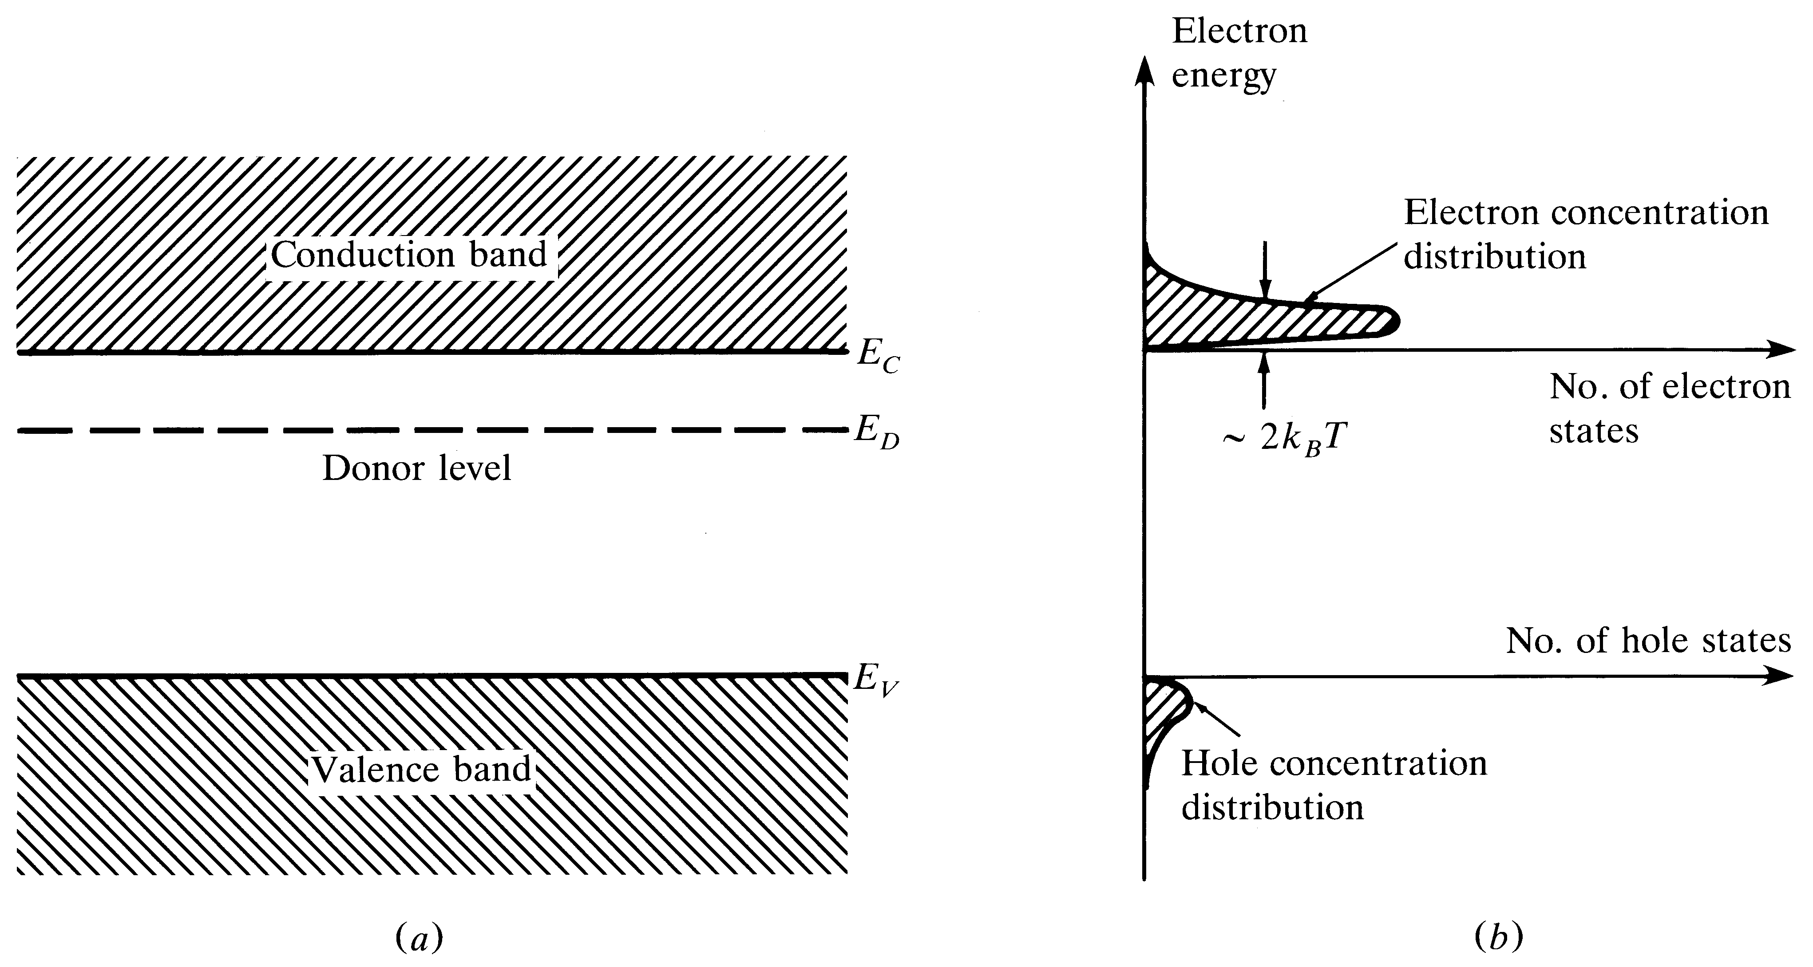
n-Type Semiconductor
Donor level in an n-type semiconductor.
The ionization of donor impurities creates an increased electron concentration distribution.
Optical Fiber communications, 3rd ed.,G.Keiser,McGrawHill, 2000

Slide 33
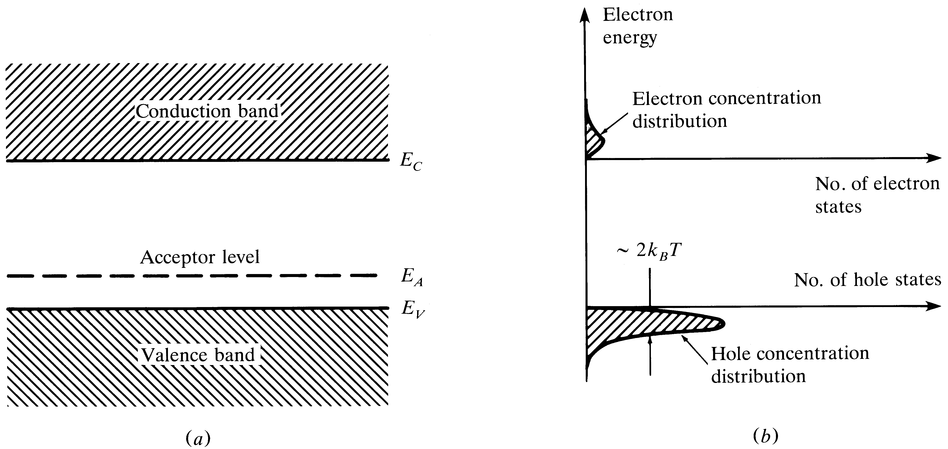
p-Type Semiconductor
Acceptor level in an p-type semiconductor.
The ionization of acceptor impurities creates an increased hole concentration distribution
Optical Fiber communications, 3rd ed.,G.Keiser,McGrawHill, 2000

Slide 34
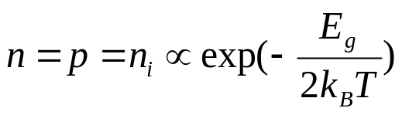


Intrinsic & Extrinsic Materials
Intrinsic material: A perfect material with no impurities.
Extrinsic material: donor or acceptor type semiconductors.
Majority carriers: electrons in n-type or holes in p-type.
Minority carriers: holes in n-type or electrons in p-type.
The operation of semiconductor devices is essentially based on the injection and extraction of minority carriers.
[4-1]
[4-2]

